Slide 1
Counting and recognizing non-moving objects by means of image processing
ESAT 1A1
Co-titular: Tinne Tuytelaars
Coaches: Xuanli Chen & José Oramas
Realised by: Max Beerten, Brent De Bleser, Wouter Devos,
Ben Fidlers, Simon Gulix, Tom Kerkhofs

Slide 2
Table of contents
Introduction
Problem description
Hardware
Software
Depth
Overlap
Colour
Application
Flaws
GUI
Conclusion

Slide 3
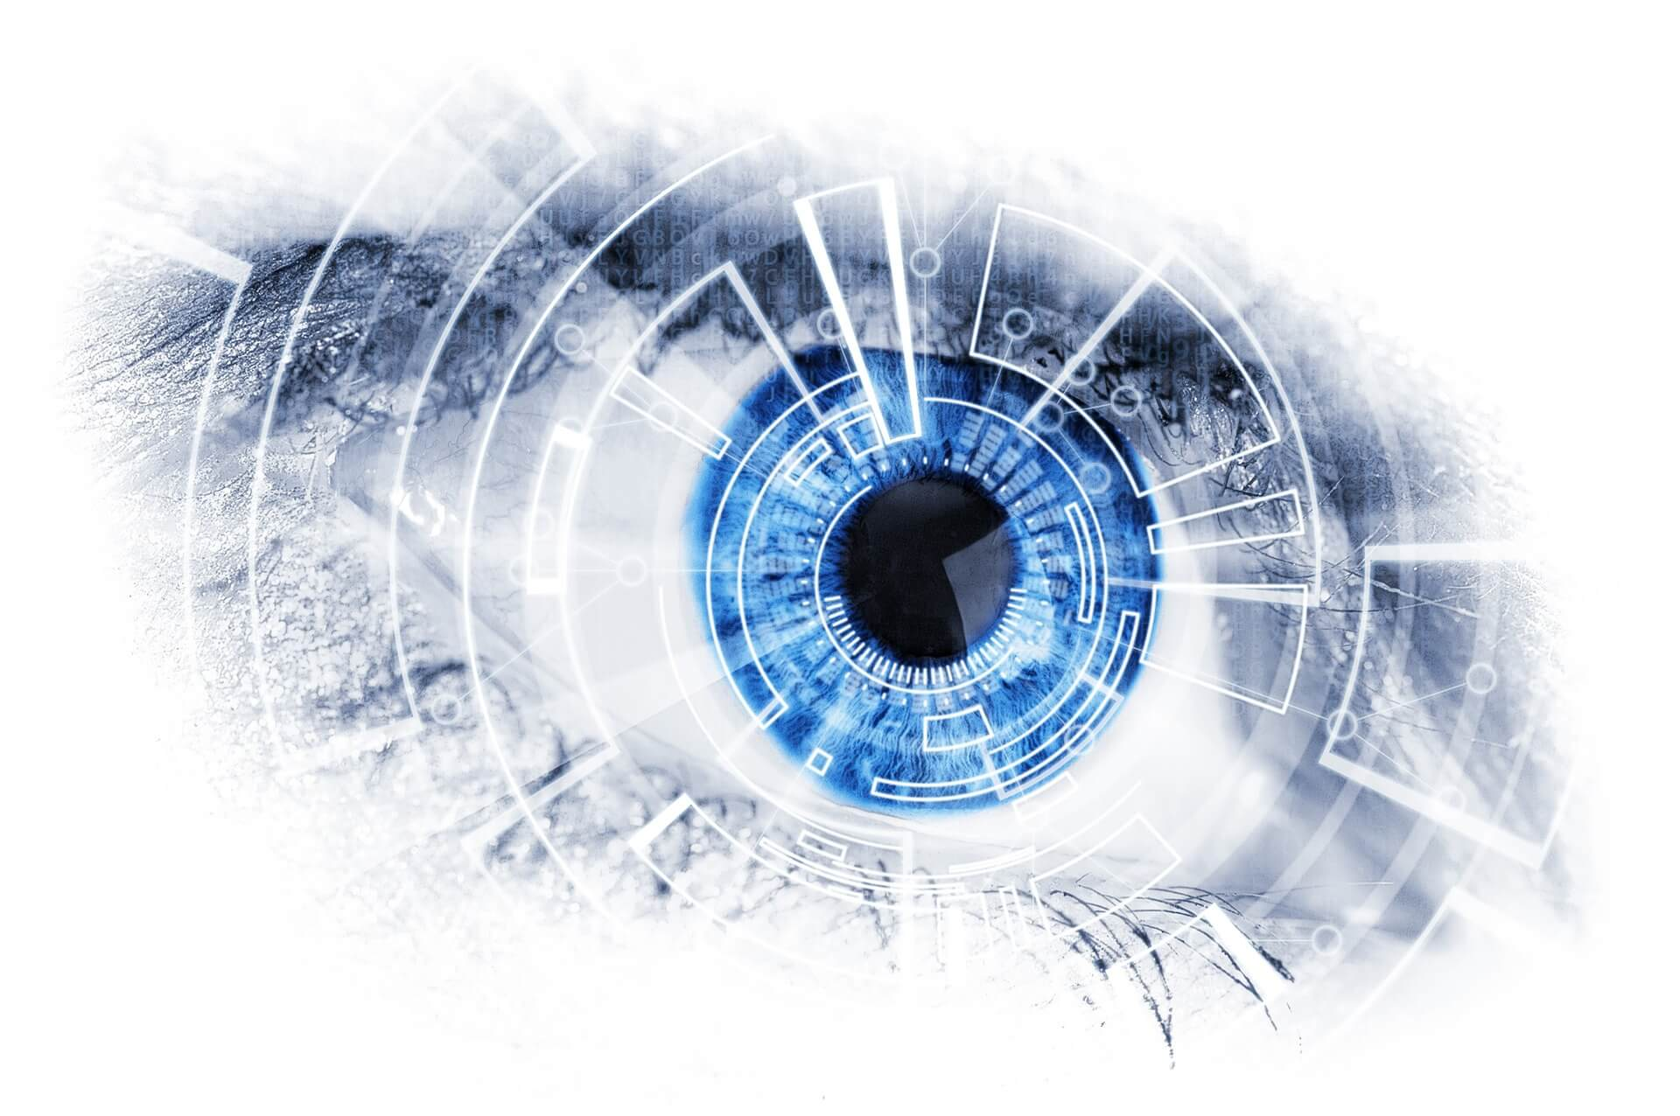
1. Introduction
Object counting using image processing
AI and machine learning
PSI at ESAT
Retrieved from DevisionX ¹
¹ Why you should integrate machine vision in your production process? (02/02/18). Retrieved (22/11/2018), from https://devisionx.com

Slide 4
Table of contents
Introduction
Problem description
Hardware
Software
Depth
Overlap
Colour
Application
Flaws
GUI
Conclusion

Slide 5
2. Problem description
FOTO DIE IN DE OPGAVE STOND
Camera
Objects of uniform colour and shape

Slide 6
Table of contents
Introduction
Problem description
Hardware
Software
Depth
Overlap
Colour
Application
Flaws
GUI
Conclusion

Slide 7
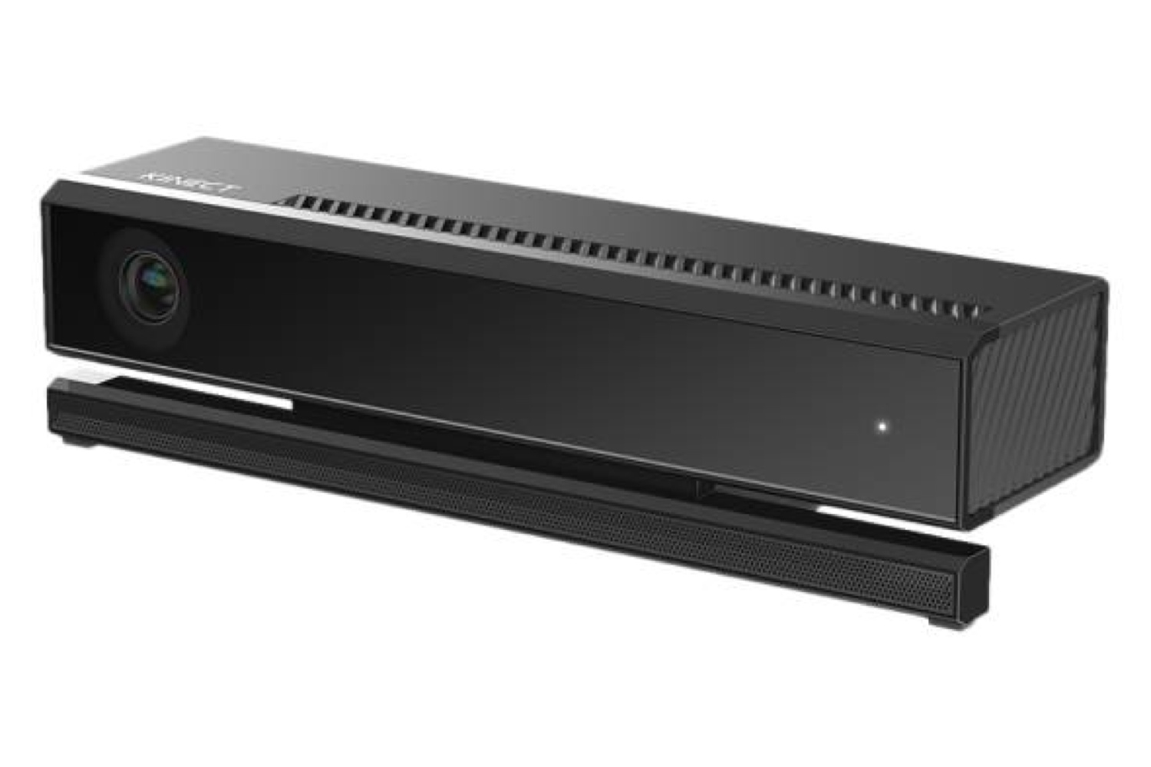
3. Hardware
Hardware components:
Camera
Wire
PC
Box
Retrieved from Time ²
FOTO BOX
² Why you should integrate machine vision in your production process? (07/07/14). Retrieved (14/12/2018), from http://time.com/2962269/kinect-v2-0-for-windows/

Slide 8
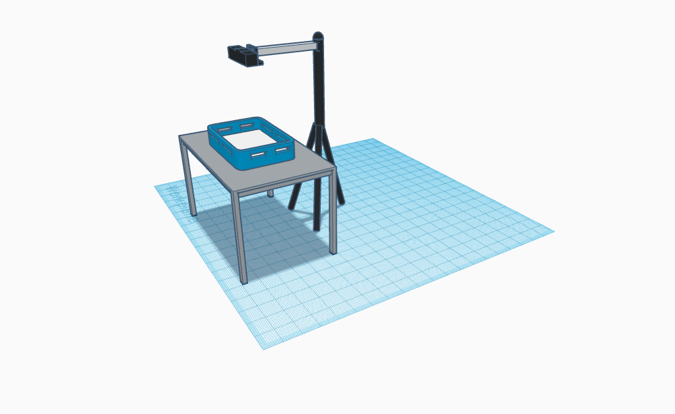
3. Hardware
Visual setup:
Height
Angle
Lighting

Slide 9
Table of contents
Introduction
Problem description
Hardware
Software
Depth
Overlap
Colour
Application
Flaws
GUI
Conclusion

Slide 10
4. Software

Slide 11
Table of contents
Introduction
Problem description
Hardware
Software
Depth
Overlap
Colour
Application
Flaws
GUI
Conclusion

Slide 12
3.a Depth

Slide 13
Table of contents
Introduction
Problem description
Hardware
Software
Depth
Overlap
Colour
Application
Flaws
GUI
Conclusion

Slide 14
3.b Overlap

Slide 15
Table of contents
Introduction
Problem description
Hardware
Software
Depth
Overlap
Colour
Application
Flaws
GUI
Conclusion

Slide 16
3.c Colour

Slide 17
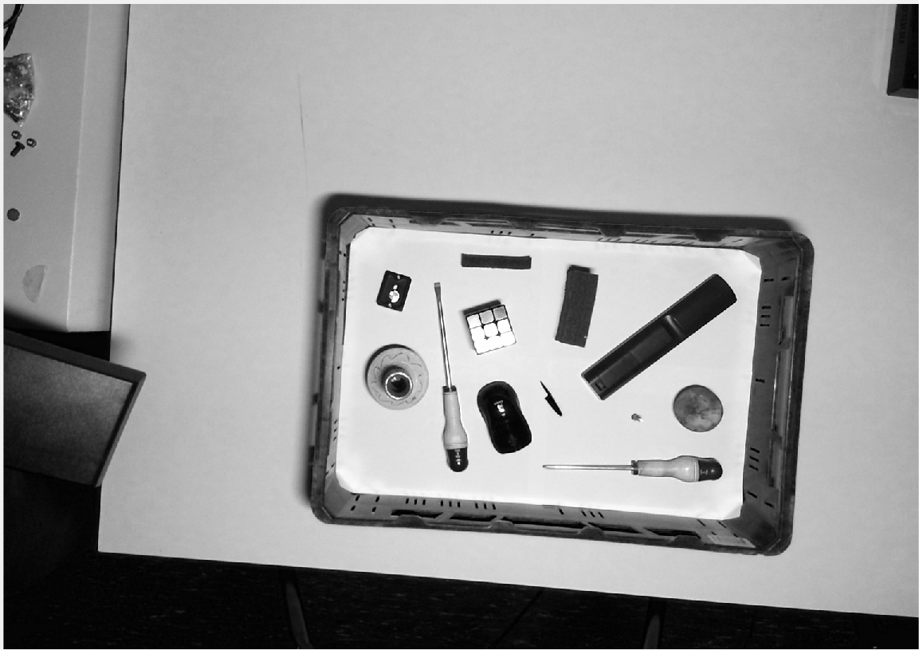
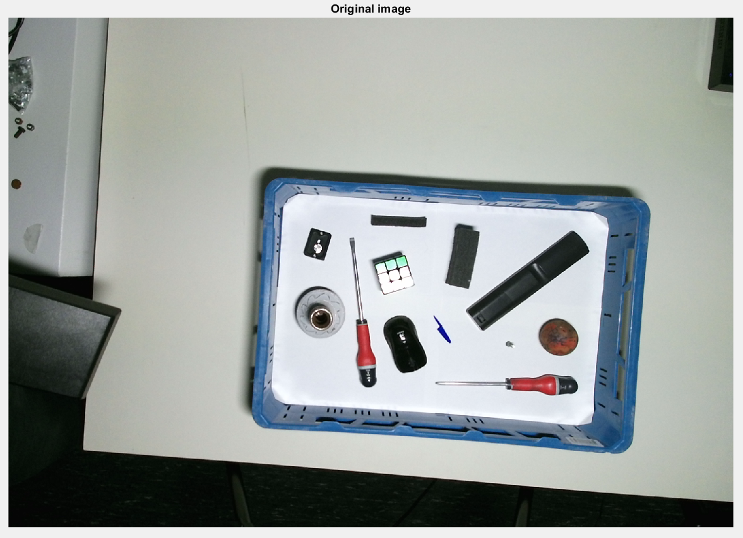
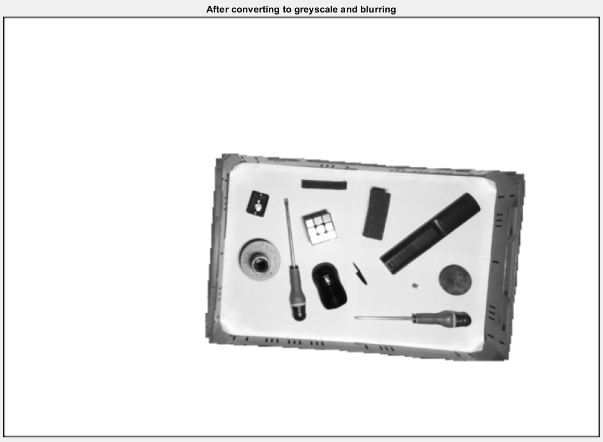
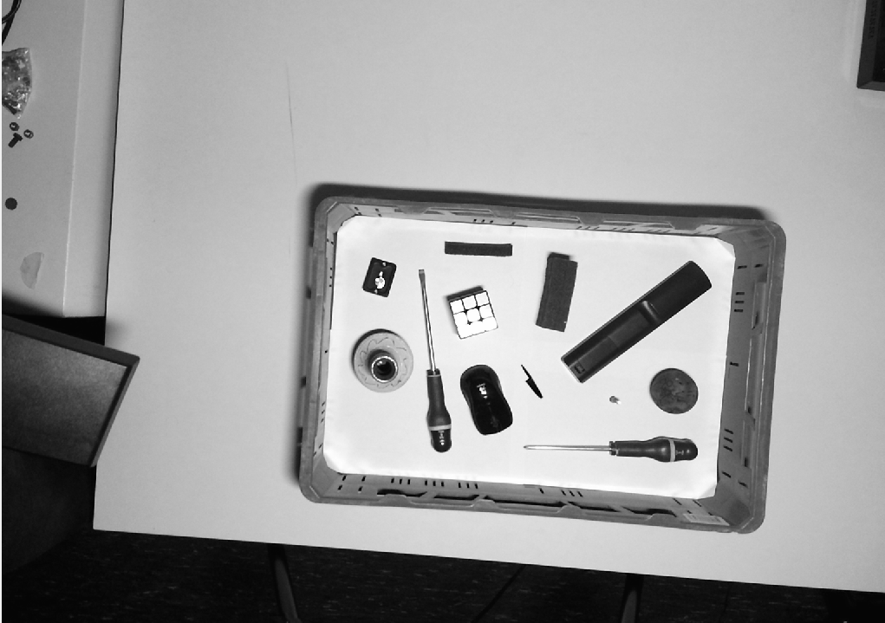
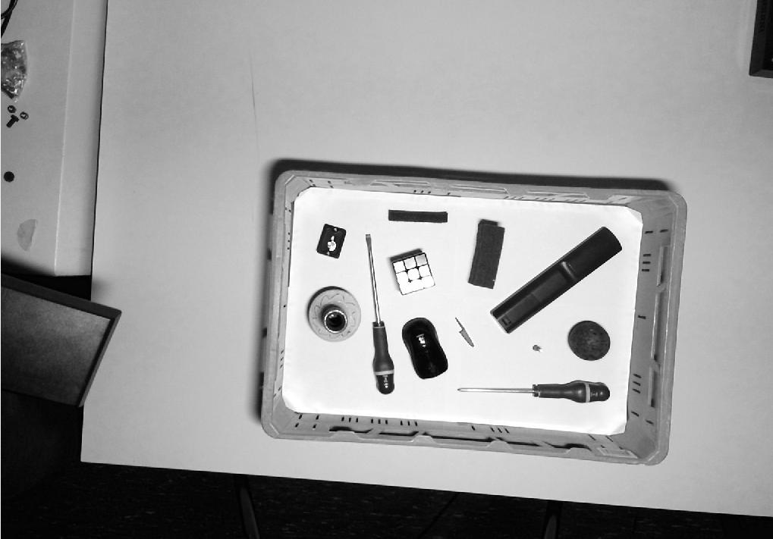
Step 1: Converting to greyscale
Red
0.2989
Green
0.5870
0.1140
Blue

Slide 18
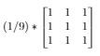
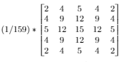
Step 2: Blurring
First a mean blur, than a gaussian blur.
Mean kernel
Gaussian kernel
*
*

Slide 19
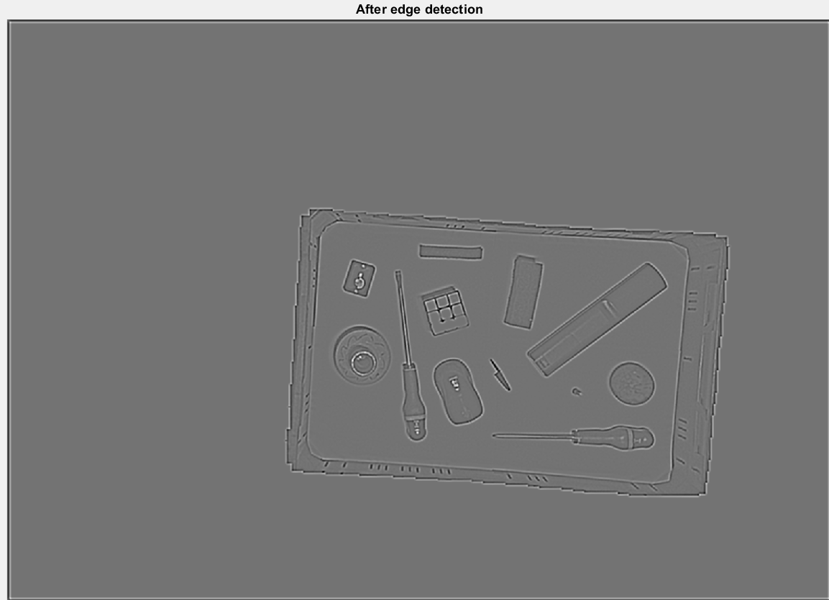
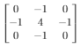
Step 3: Edge detection
*
=

Slide 20
Problem with convolutions
0
0
0
0
0
0
0
0
0
0
00000000000000
Remove_boundary()

Slide 21
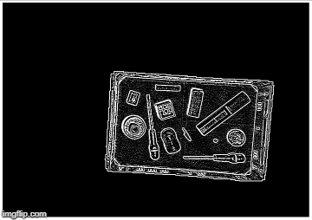
Step 4: Thresholding edge
Notice the white border

Slide 22

Step 5: Grouping

Slide 23
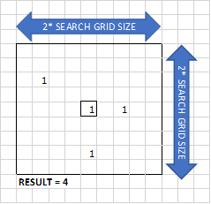
Loop through every pixel:
Check if pixel is black
Count same pixels values in grid
Check if that amount of pixels is big enough
Search for group number in grid (No group found? -> assign new group number)
Place group number in matrix

Slide 24
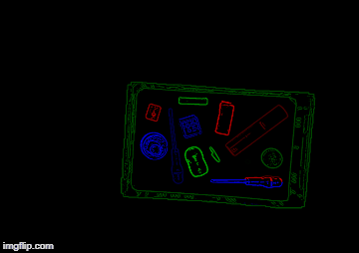
Step 6: Regrouping
Loop through every pixel (right-top to left-bottom)
Check if group number is not 0.
Check if there is another group in the X-pixels below this pixel.
Replace group number of the bottom group with the top group number.

Slide 25
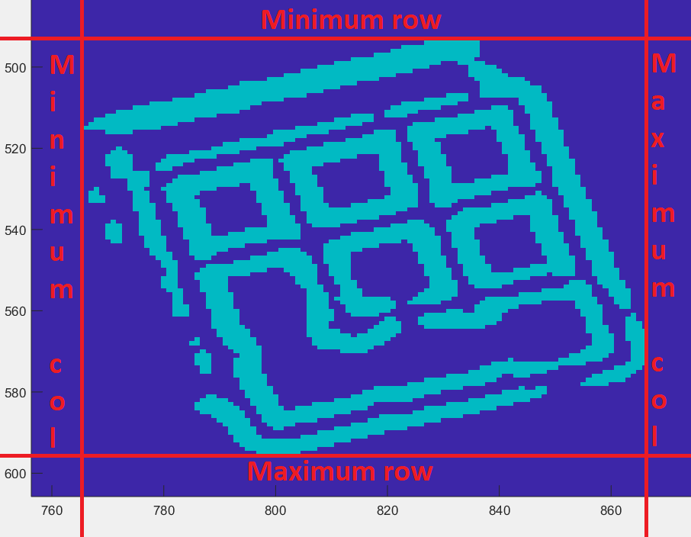
Step 7: Drawing boundary boxes

Slide 26
Table of contents
Introduction
Problem description
Hardware
Software
Depth
Overlap
Colour
Application
Flaws
GUI
Conclusion

Slide 27
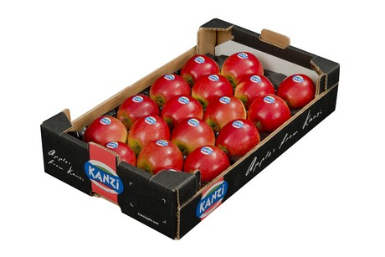
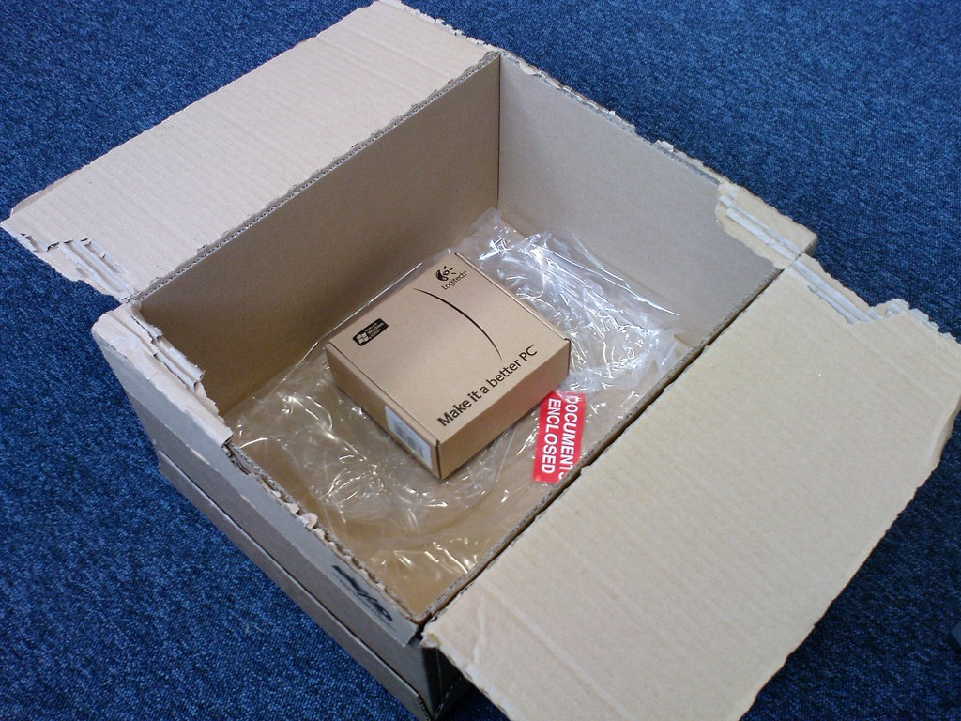
5. Application
Engineering project
Counting uniform objects
Optimal object packaging
Retrieved from Freshplaza ³
Solving the Box Selection Algorithm
Retrieved from Medium ⁴
³ Preis für Kanzi erzielt Rekordhöhe (06/03/18). Retrieved (15/12/2018), from https://www.freshplaza.de/artikel/5015819/preis-fuer-kanzi-erzielt-rekordhoehe/
⁴ Solving the Box Selection Algorithm (01/07/16). Retrieved (14/12/2018), from https://medium.com/the-chain/solving-the-box-selection-algorithm-8695df087a4

Slide 29
Table of contents
Introduction
Problem description
Hardware
Software
Depth
Overlap
Colour
Application
Flaws
GUI
Conclusion

Slide 30
6. Flaws

Slide 31
Table of contents
Introduction
Problem description
Hardware
Software
Depth
Overlap
Colour
Application
Flaws
GUI
Conclusion

Slide 32
7. GUI

Slide 33
Table of contents
Introduction
Problem description
Hardware
Software
Depth
Overlap
Colour
Application
Flaws
GUI
Conclusion

Slide 34
8. Conclusion

